Slide 1
Email Triage Using LLM
Debatosh Pradhan
Saswat Das
Pooja Soni

Slide 2
We have utilised google colab and gemini free version to generate email triage.
For api we are utilising gradio .which light weigh and ready to use api .
Its giving us proper result for Request type and sub request type .

Slide 3
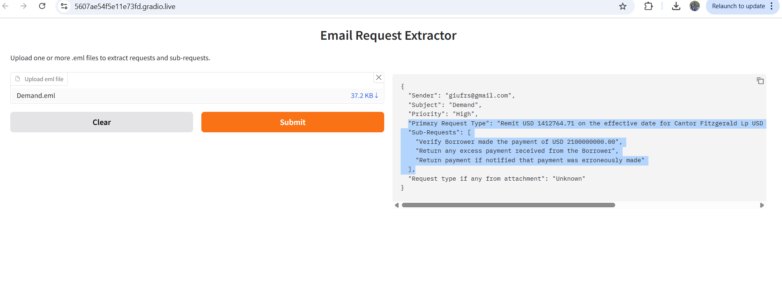

Slide 4
Triage with RAG
We did try to implement Triage with Rag too.
It also providing us desired result for Request Type ,Sub Request Type .

